Slide 1


Modern Bayesian Experimental Design
Tom Rainforth
ML in PL 04/11/24

Slide 2
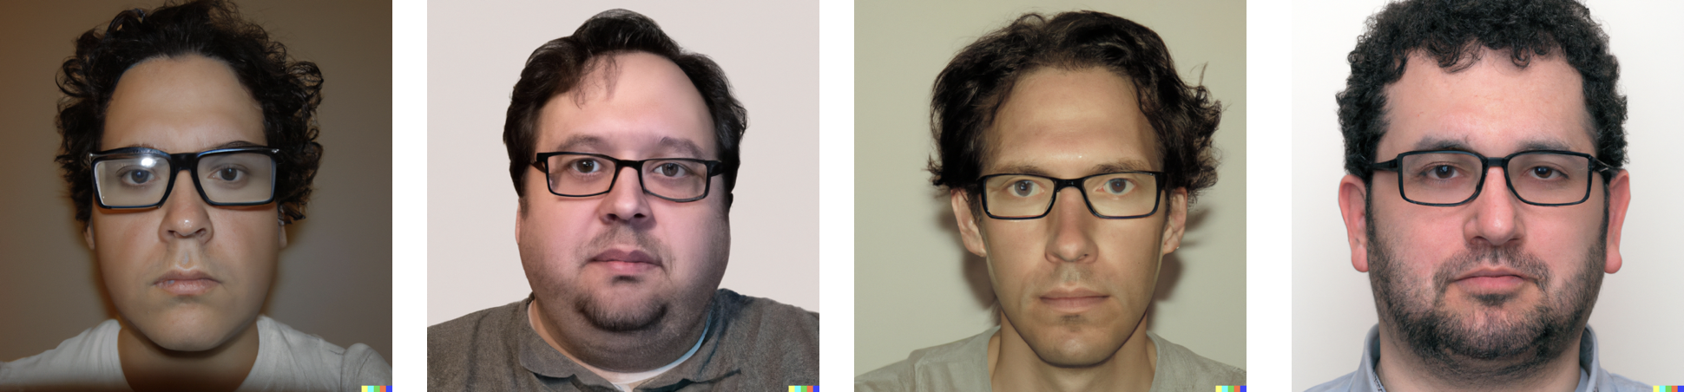
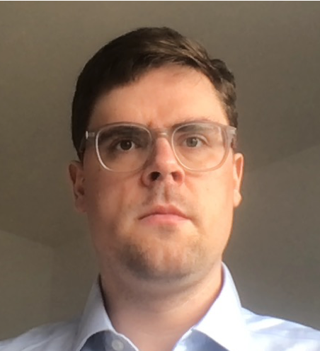

Slide 3
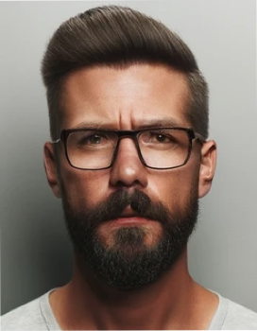
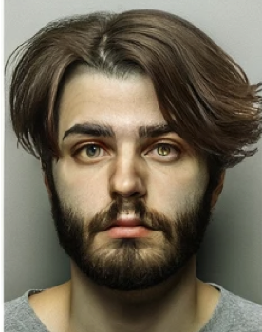
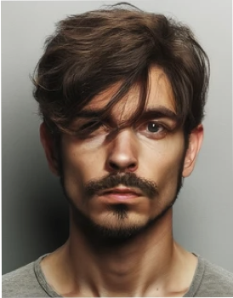
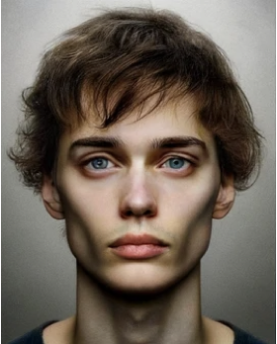
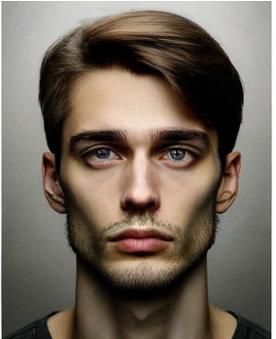
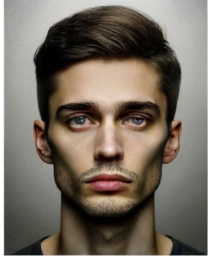
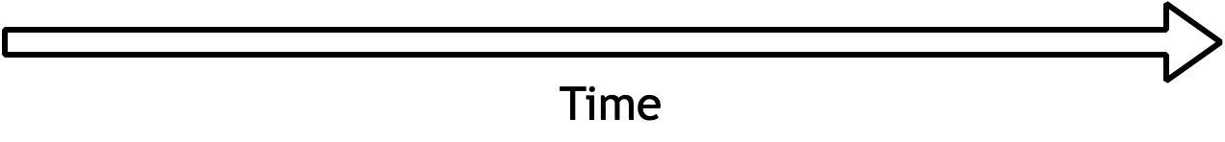
Better, paler skin
Close, little older
Terrible
Too fat
That’s him!
True Suspect

Slide 4
Machine Learning Pipeline
Data Gathering
Modelling
Decision Making, Prediction
Notes:
From psychological trials and virtual assistants, to drug discovery and market research, the design of experiments is a fundamental challenge throughout almost all of science and industry. Better experiments lead to better data, while good quality data is a cornerstone of much of the modern world. This makes experimental design a crucial topic for research, but one that is currently often neglected compared with the vast swathes of investigation being undertaken on how best to use data once we have acquired it.

Slide 5
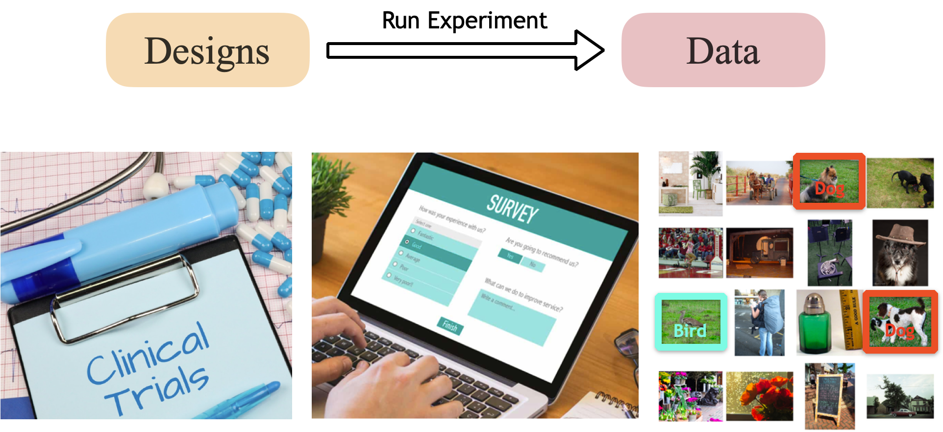
Data Gathering = Experimental Design
Notes:
From psychological trials and virtual assistants, to drug discovery and market research, the design of experiments is a fundamental challenge throughout almost all of science and industry. Better experiments lead to better data, while good quality data is a cornerstone of much of the modern world. This makes experimental design a crucial topic for research, but one that is currently often neglected compared with the vast swathes of investigation being undertaken on how best to use data once we have acquired it.

Slide 6
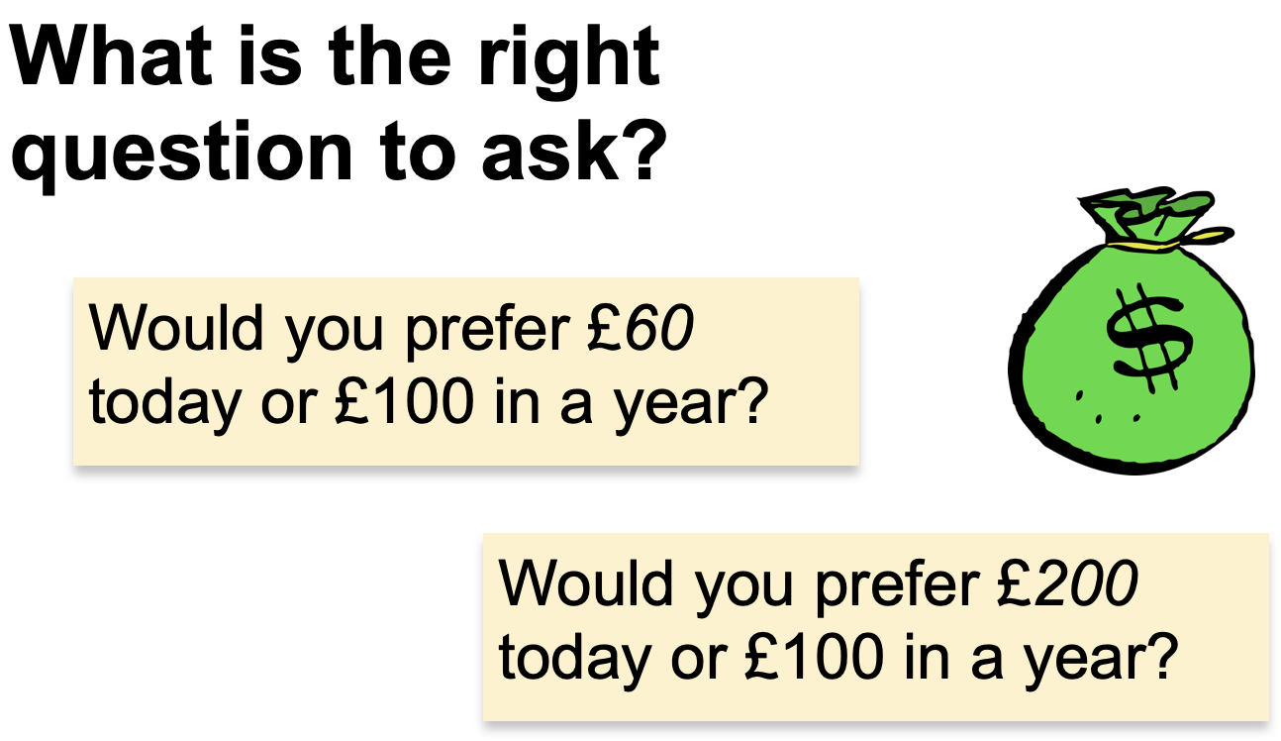

Slide 7
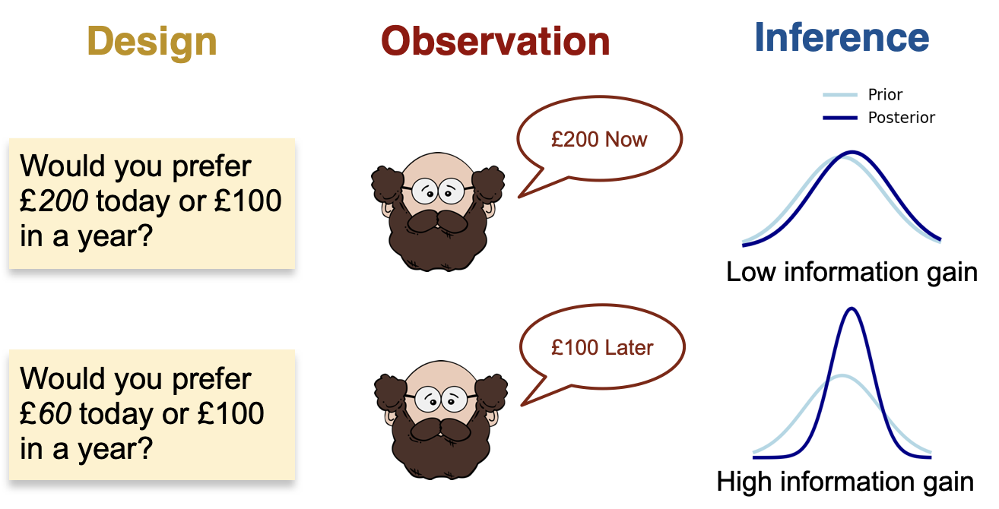
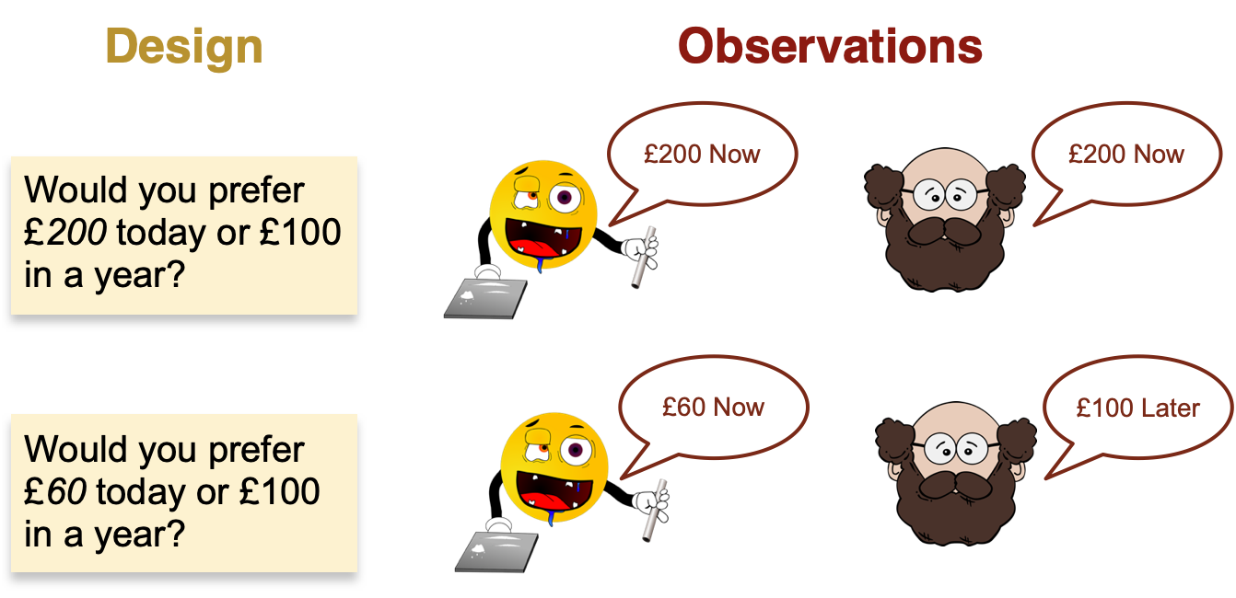

Slide 8
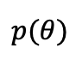
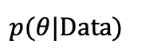
$$p(θ)$$
$$p(θ|Data)$$
Notes:
What do we mean by adaptive experimentation.
Explain the cycle starting with design.

Slide 9
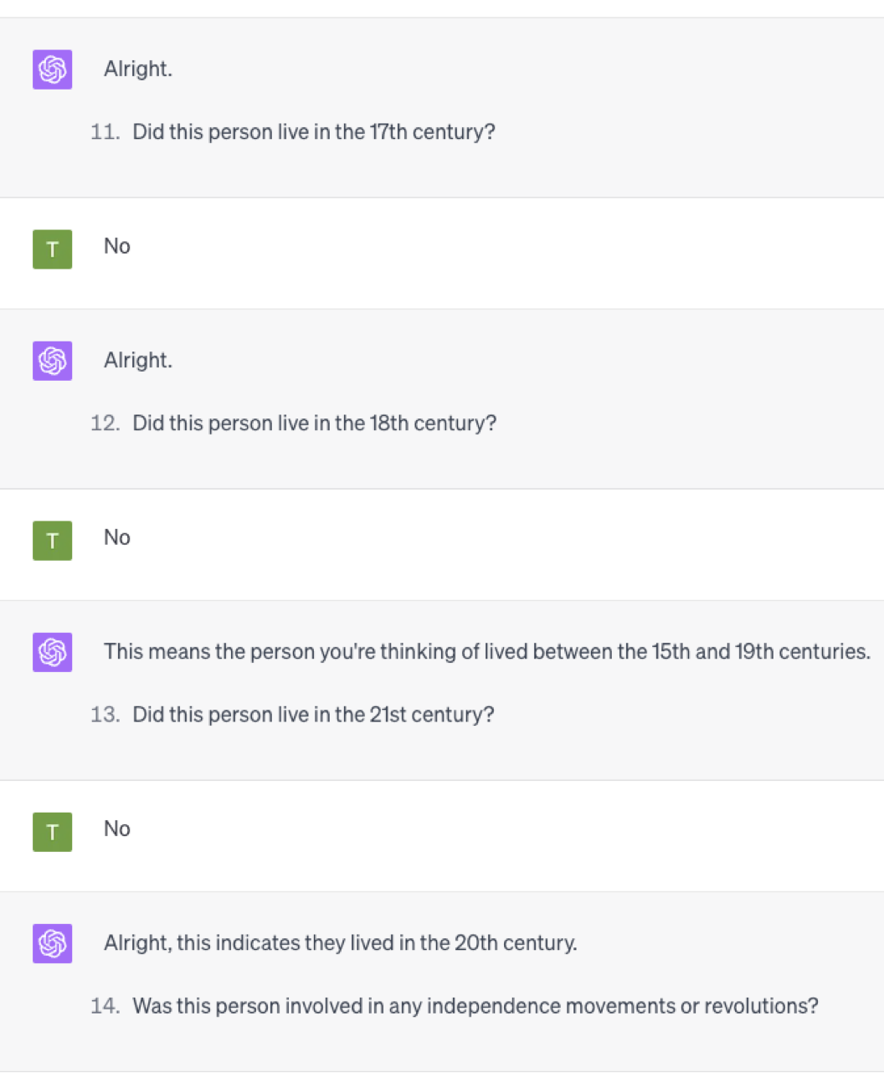
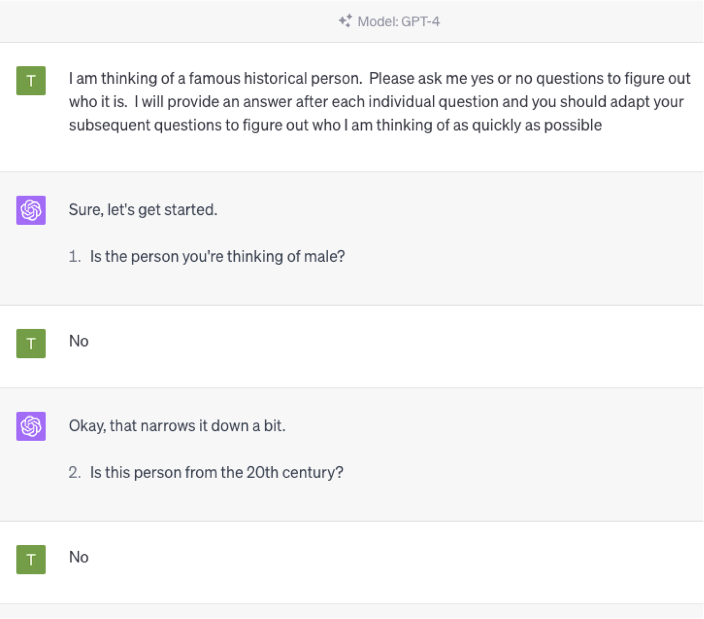
Notes:
From psychological trials and virtual assistants, to drug discovery and market research, the design of experiments is a fundamental challenge throughout almost all of science and industry. Better experiments lead to better data, while good quality data is a cornerstone of much of the modern world. This makes experimental design a crucial topic for research, but one that is currently often neglected compared with the vast swathes of investigation being undertaken on how best to use data once we have acquired it.

Slide 10

What Makes Good Data?
Notes:
From psychological trials and virtual assistants, to drug discovery and market research, the design of experiments is a fundamental challenge throughout almost all of science and industry. Better experiments lead to better data, while good quality data is a cornerstone of much of the modern world. This makes experimental design a crucial topic for research, but one that is currently often neglected compared with the vast swathes of investigation being undertaken on how best to use data once we have acquired it.

Slide 11
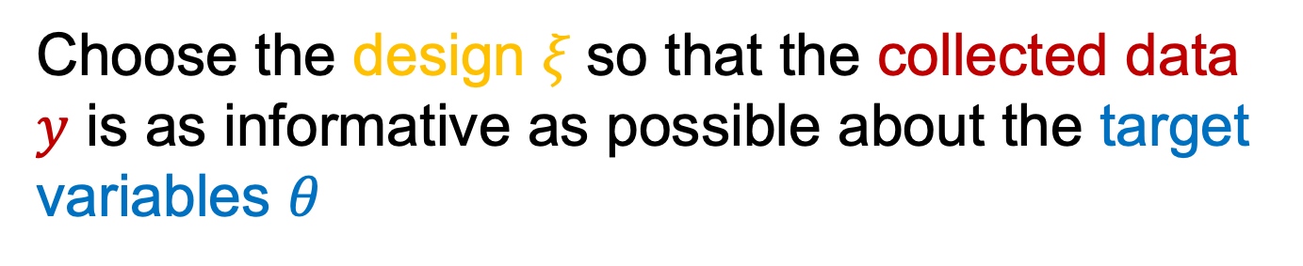
Information-Theoretic Experimental Design Approach
Choose the design $ξ$so that the collected data $y$ is as informative as possible about the target variables $θ$
Notes:
What do we mean by adaptive experimentation.
Explain the cycle starting with design.

Slide 12
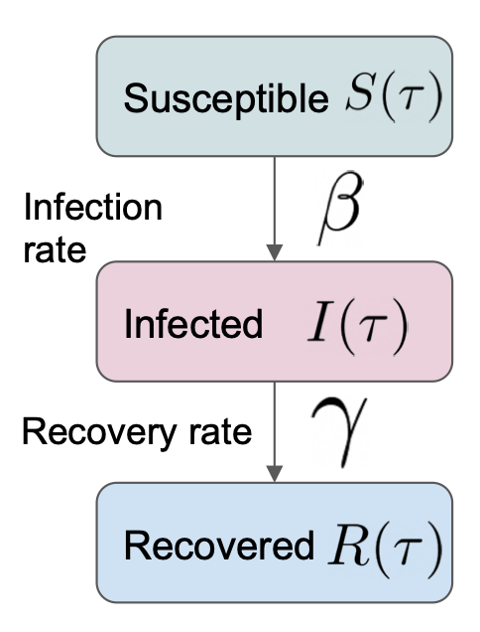
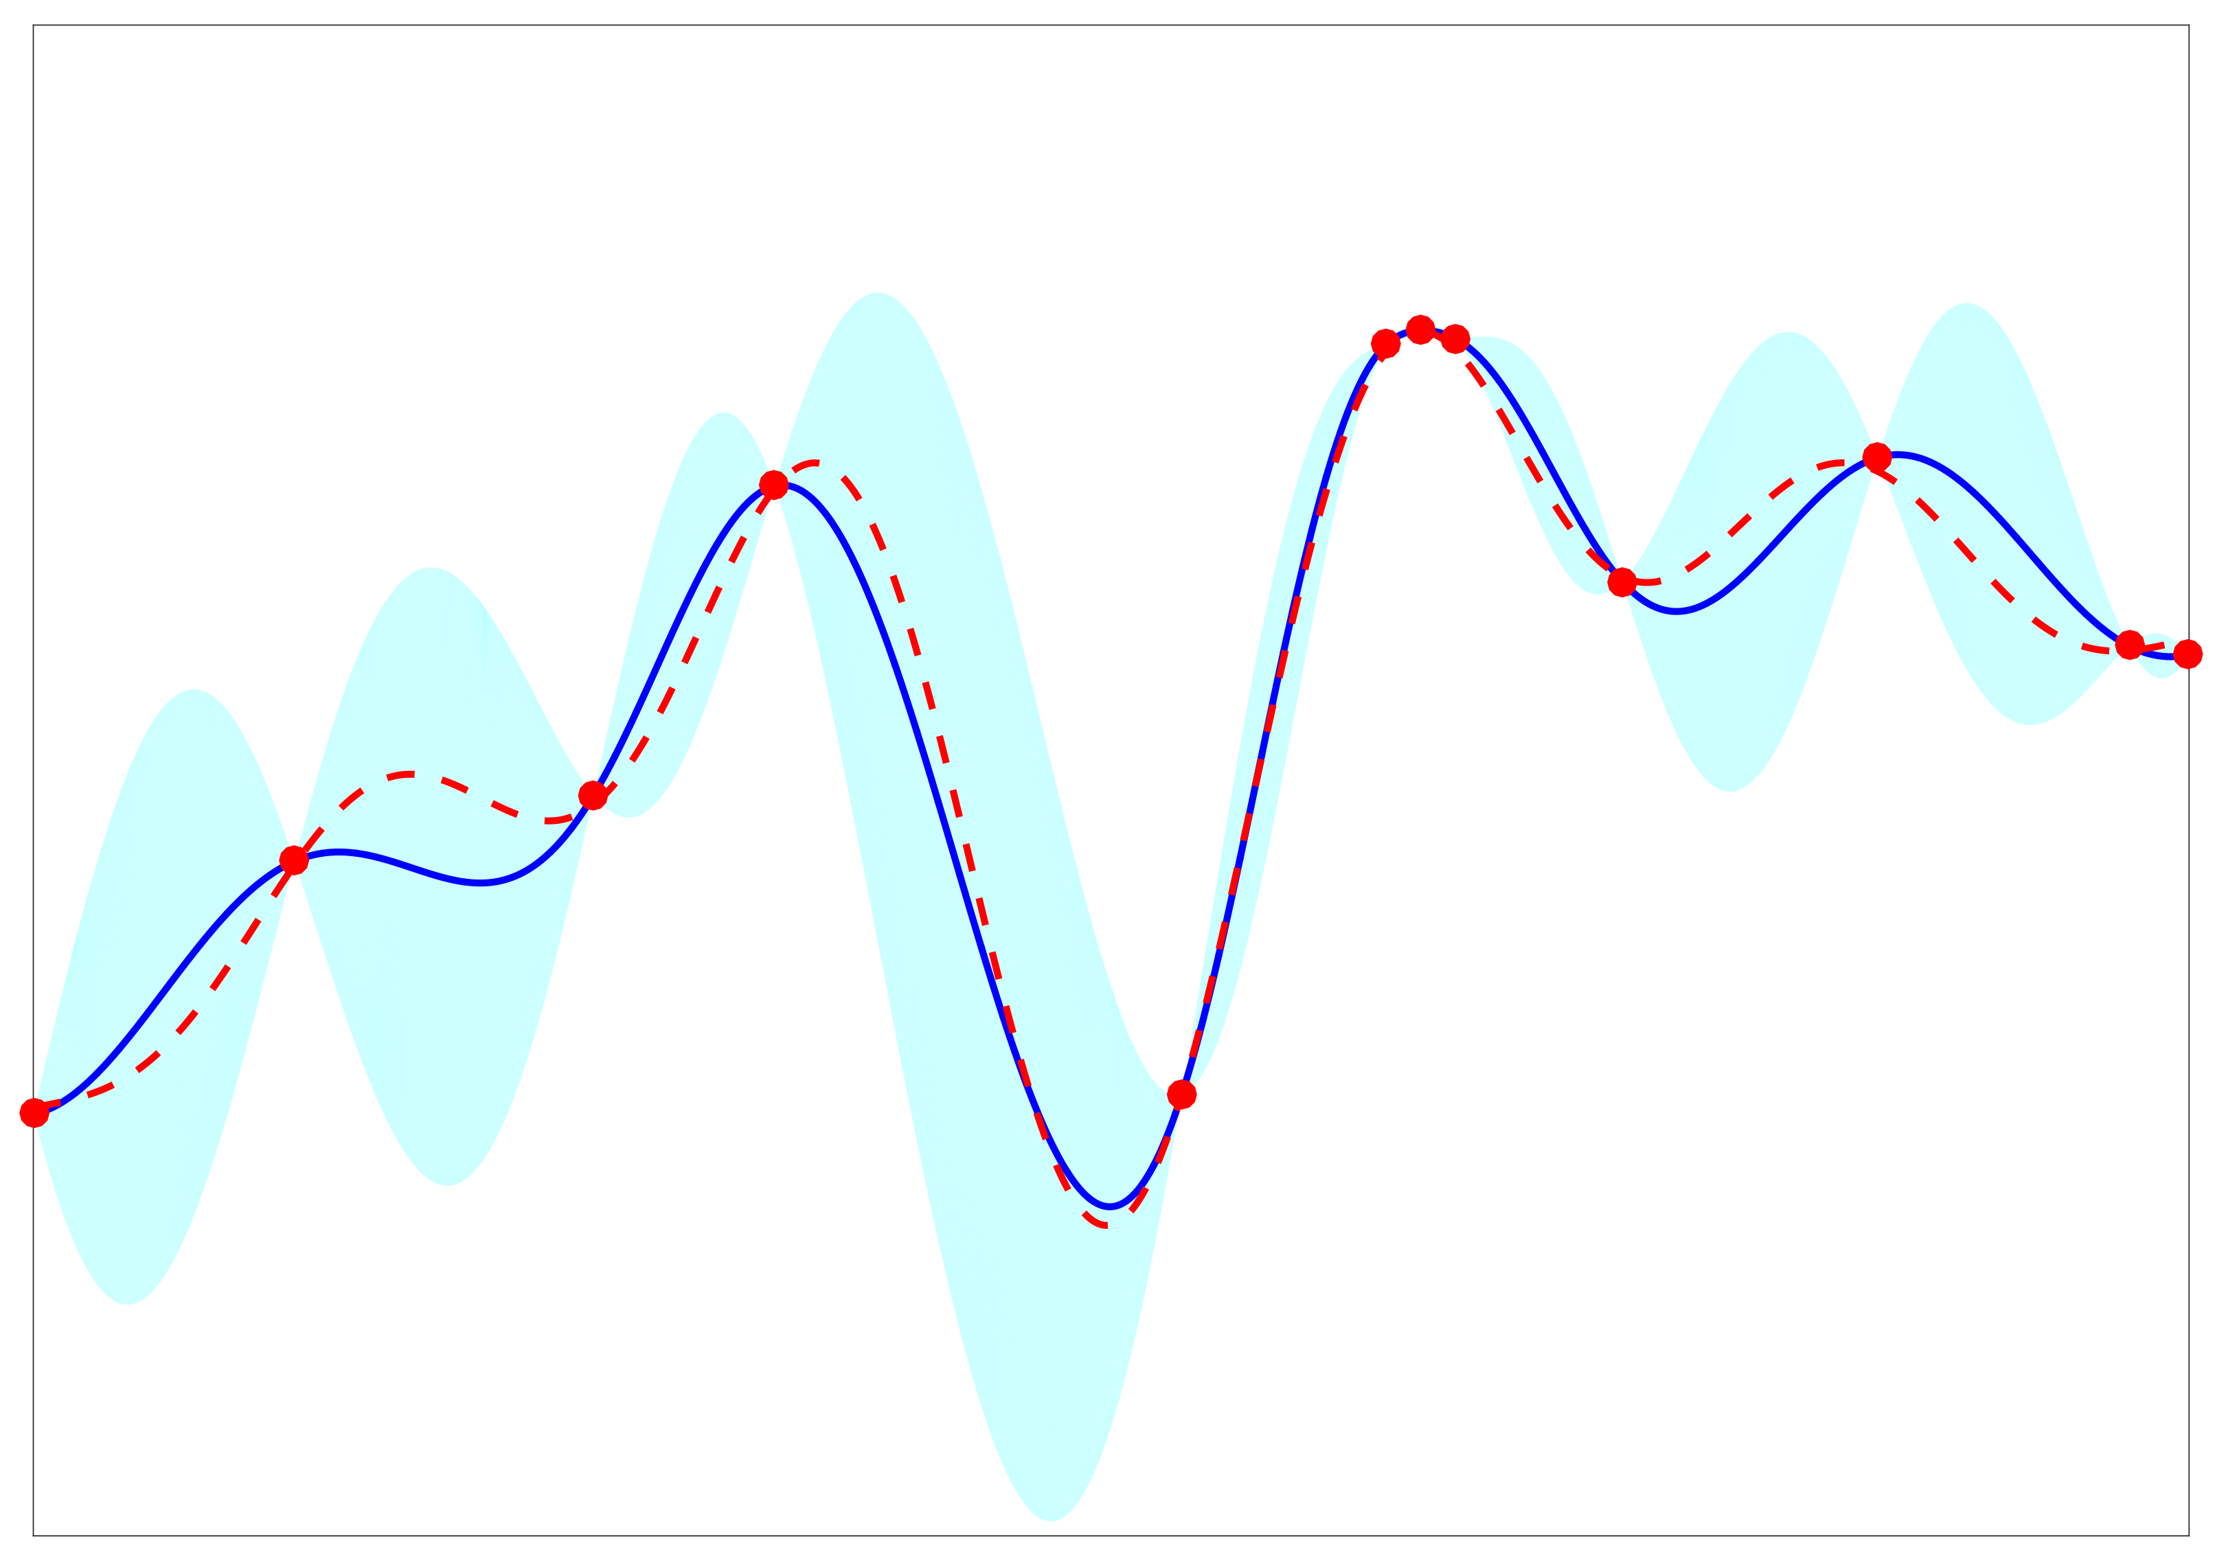
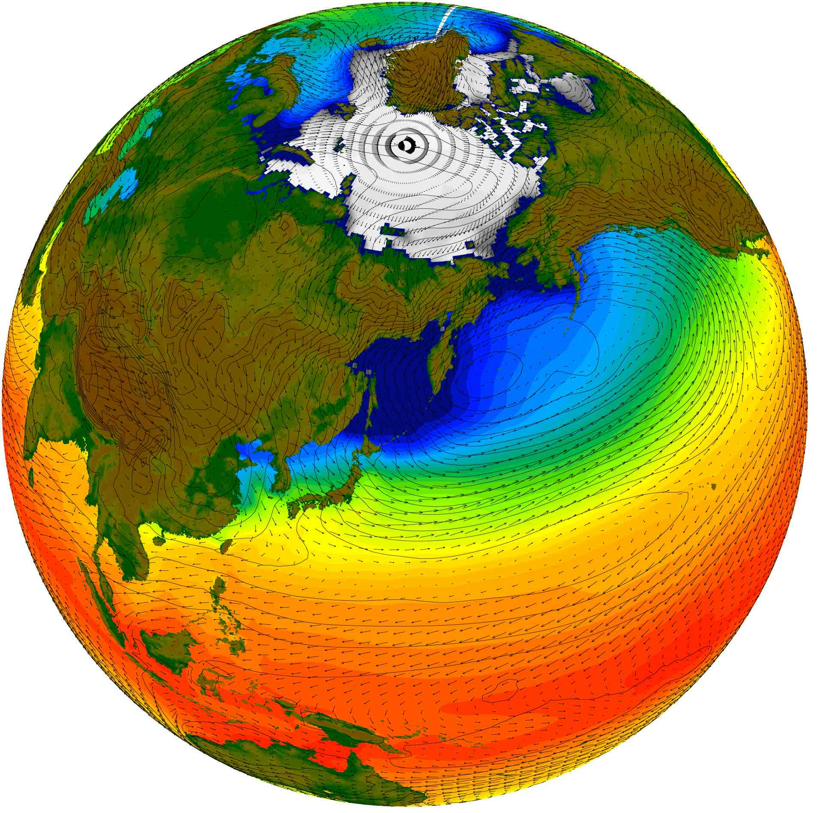
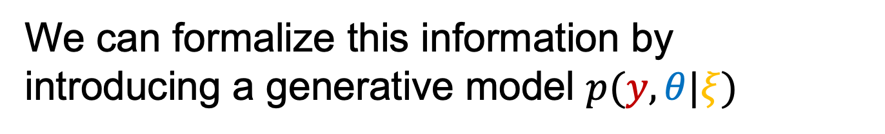
Bayesian Experimental Design
We can formalize this information by introducing a generative model $p(y,θ|ξ)$
Notes:
What do we mean by adaptive experimentation.
Explain the cycle starting with design.

Slide 13
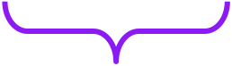

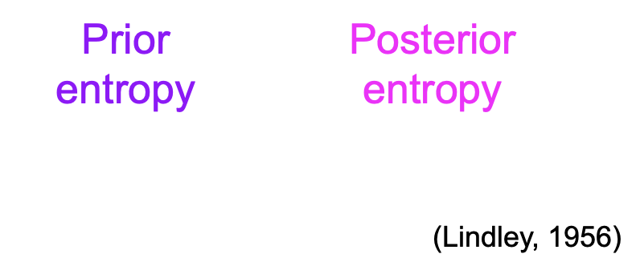
Information gain
Notes:
** Informative experiment. What is learning? Information requires a model. Reasoning about unknown model latent variable. Formalize what it means to gain informaiton.
**Mention model. Concept of a model. Learning a good latent variable- learning a good model.
What distinguishes a good design from a bad design? A good design is one which allows us to gain information about the latent variable and so learn a **better model**. We can measure this using *information gain* which is the difference in entropy between the prior and posterior. Larger information gain means that we have become much more certain about the value of the unknown latent variable by doing the experiment.

Slide 14
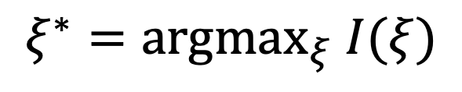
Expected information gain (EIG)
We use our model both to define the information gain and to approximate the true distributions over outcomes
$$ξ^{∗}=argmax_{ξ} I(ξ)$$
Notes:
\xiInformation gain depends on the unseen observation. To turn it into a criterion for selecting between designs, we take the expectation over the observation. This gives expected information gain, I, the key quantity that measures how much the design is likely to improve the model.

Slide 15
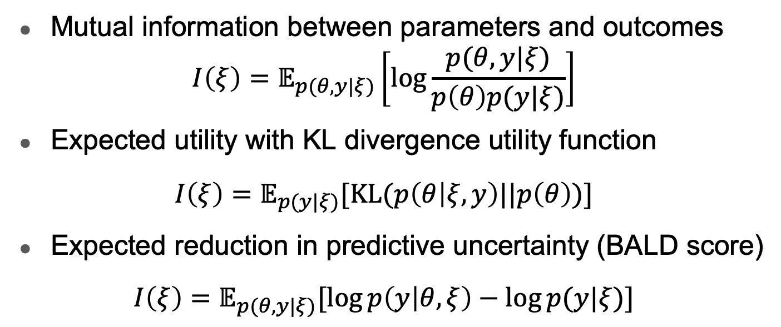
Alternative Interpretations of EIG
Mutual information between parameters and outcomes $I\left(ξ\right)=𝔼_{p(θ,y|ξ)}\left[\log{\frac{p(θ,y|ξ)}{p\left(θ\right)p(y|ξ)}}\right]$
Expected utility with KL divergence utility function $I\left(ξ\right)=𝔼_{p(y|ξ)}[KL(p\left(θ | ξ,y\right)||p\left(θ\right))]$
Expected reduction in predictive uncertainty (BALD score) $I\left(ξ\right)=𝔼_{p(θ,y|ξ)}[\log{p\left(y | θ,ξ\right)−\log{p(y|ξ)}}]$

Slide 16
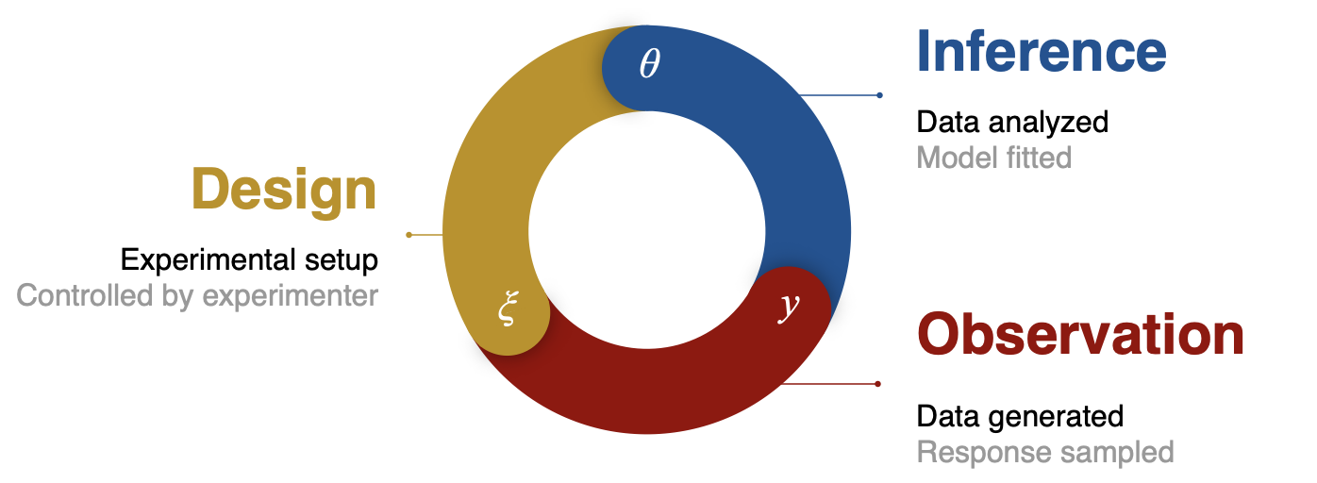

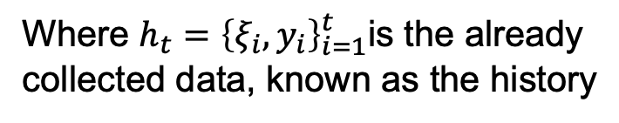
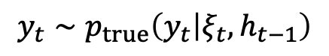
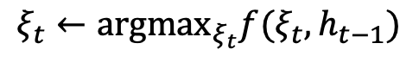
Bayesian Adaptive Design (BAD)
$$ξ_{t}←{argmax}_{ξ_{t}}f(ξ_{t},h_{t−1})$$
Where $h_{t}={\left\{ξ_{i},y_{i}\right\}}_{i=1}^{t}$is the already collected data, known as the history
$${y_{t}∼p}_{true}\left(y_{t} | ξ_{t},h_{t−1}\right)$$
Notes:
\xi

Slide 17
Adaptive online surveys
AI powered by DAD
Would you prefer £80 today, or £100 in 3 months?
Human participant
AI powered by DAD
£80 today
Would you prefer £70 today, or £100 in 4 weeks?
Human participant
AI powered by DAD
£70 today
Would you prefer £30 today, or £100 in 16 days?
Human participant
AI powered by DAD
£100 in 16 days
Would you prefer £38 today, or £100 in 3 weeks?
Human participant
£38 today

Slide 18
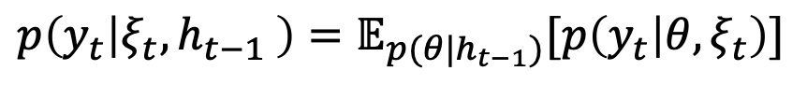
Incremental EIG
Incremental EIG at step t:
$$I\left(ξ_{t}|h_{t−1}\right)=𝔼_{p\left(y_{t} | {ξ_{t},h}_{t−1} \right)}\left[H\left[p\left(θ | h_{t−1}\right)\right]−H\left[p\left(θ | h_{t−1},ξ_{t},y_{t}\right)\right]\right]$$
Posterior entropy at t-1
Posterior entropy at t
Expectation taken over posterior predictive at t-1
$$p\left(y_{t} | {ξ_{t}, h}_{t−1} \right)=𝔼_{p(θ|h_{t−1})}[p\left(y_{t} | θ,ξ_{t}\right)]$$
Notes:
Use posterior from one iteration as the prior for the next

Slide 19

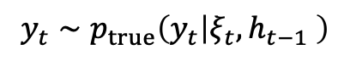
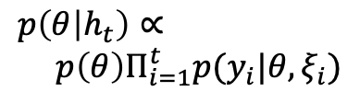
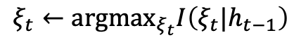
Traditional (Greedy) BAD
Update posterior approximation to incorporate new observations
$$p\left(θ | h_{t}\right)∝ \\ p\left(θ\right)Π_{i=1}^{t}p(y_{i}|θ,ξ_{i})$$
Choose new design by optimizing the conditional EIG
$$ξ_{t}←argmax_{ξ_{t}}I\left(ξ_{t}|h_{t−1}\right)$$
Sample new outcome by running experiment iteration
$${y_{t}∼p}_{true}\left(y_{t} | ξ_{t},h_{t−1} \right)$$
Notes:
\xi

Slide 20
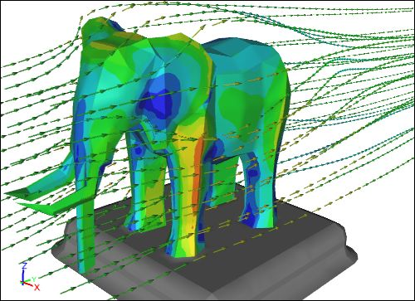
Historical Viewpoint
Bayesian experimental design “a good idea, but too computationally intensive to use in practice.”
Only used for problems of a few dimensions or where key elements can be done analytically
Still really slow even then

Slide 21
The EIG is Doubly Intractable
Actually estimating the EIG, even for one design without adaptation, is challenging!
Intractable
Doubly intractable

Slide 22
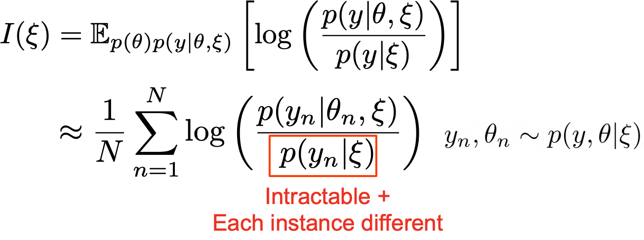
Why is EIG doubly intractable?

Slide 23
The EIG is Doubly Intractable
To actually estimate the EIG, even at one design without adaptation, is challenging!
Intractable
Doubly intractable

Slide 24
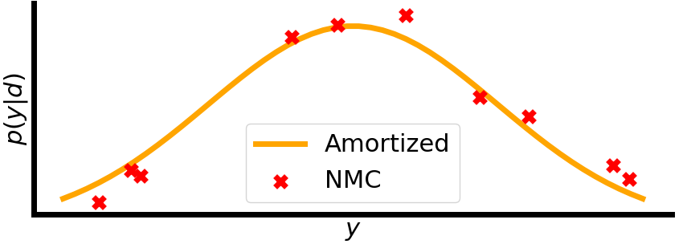
Why is NMC Inefficient?
NMC estimates $p(y|ξ)$ from scratch for each $y$ (and $ξ$)
p(y|ξ)
True marginal
Point estimates

Slide 25
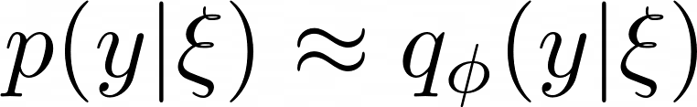
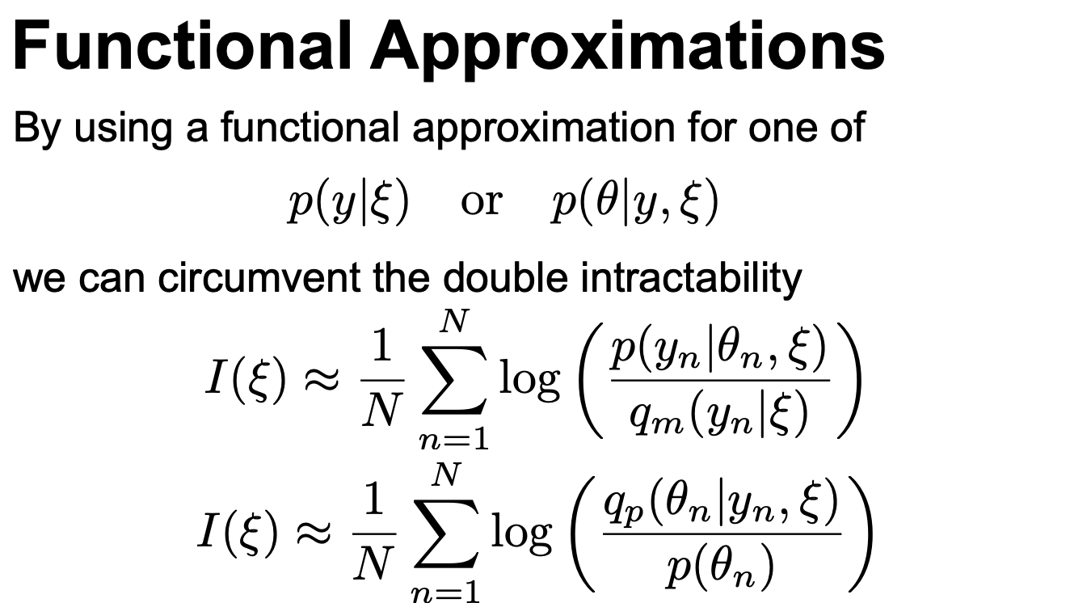

Functional Estimation
We can instead treat the problem as a stochastic regression and learn a functional approximation
$$φ$$
(Foster et al., 2019)

Slide 26
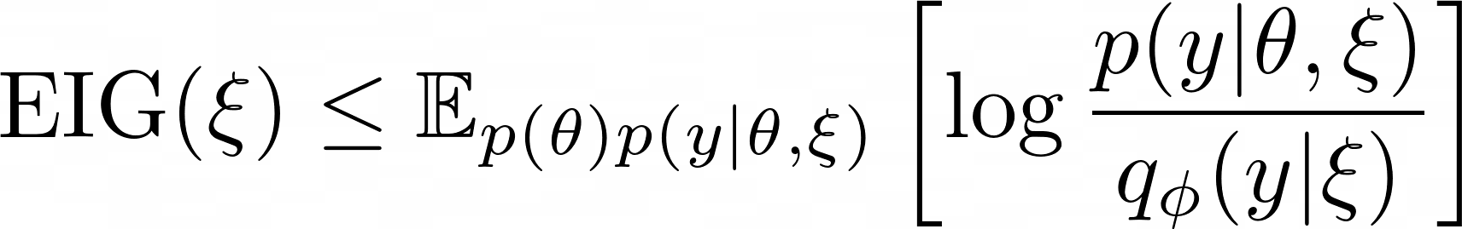
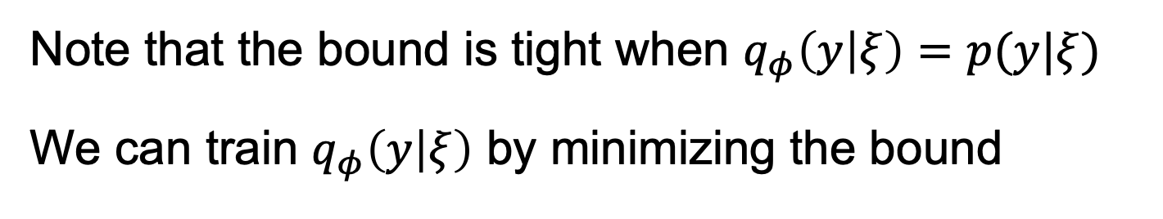
Variational EIG estimation
This turns out to not just be an approximation, it’s a variational bound
Note that the bound is tight when $q_{φ}\left(y | ξ\right)=p(y|ξ)$
We can train $q_{φ}\left(y | ξ\right)$ by minimizing the bound
(Foster et al., 2019)

Slide 27
(also known as the Barber-Agakov bound)
If we include m=0 in the average, we instead get a lower bound, known as the adaptive contrastive estimation (ACE) bound
[Barber and Agakov. NeurIPS 2003]

Slide 28
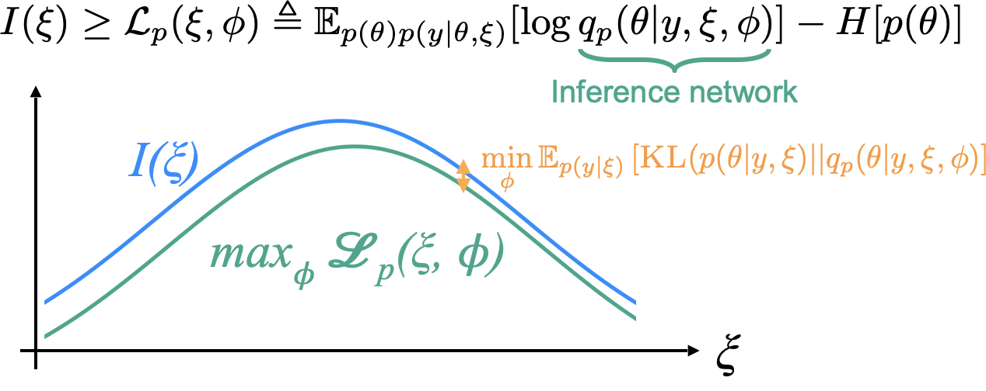
Variational EIG estimation
(Foster et al., 2019)

Slide 29
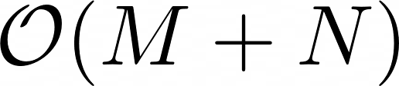
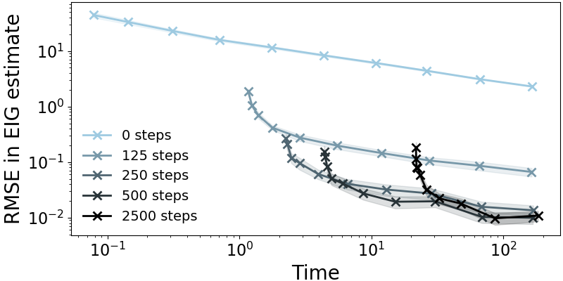
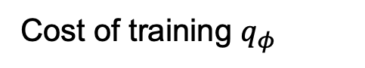
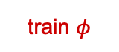
Variational EIG estimation
Why is variational estimation faster?
train $φ$
draw samples
Cost of training $q_{φ}$
Number of final samples
(Foster et al., 2019)

Slide 30
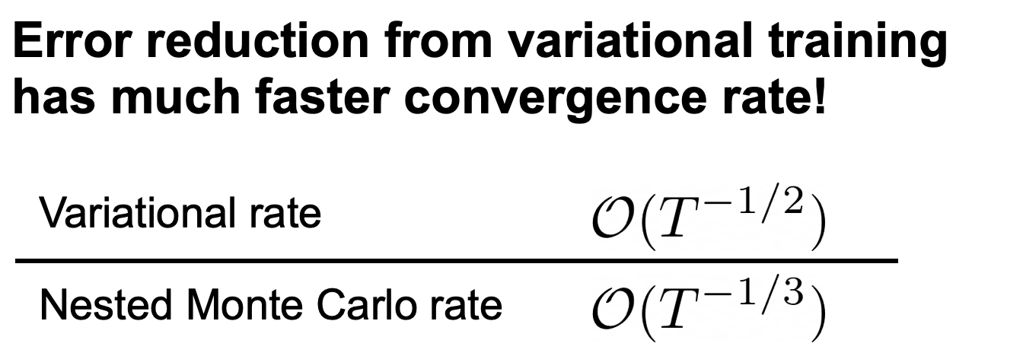
Note that both methods are biased for finite computational budgets: the normal trade-offs between Monte Carlo and variational methods do not carry over (e.g. variational methods will often yield lower bias)

Slide 31
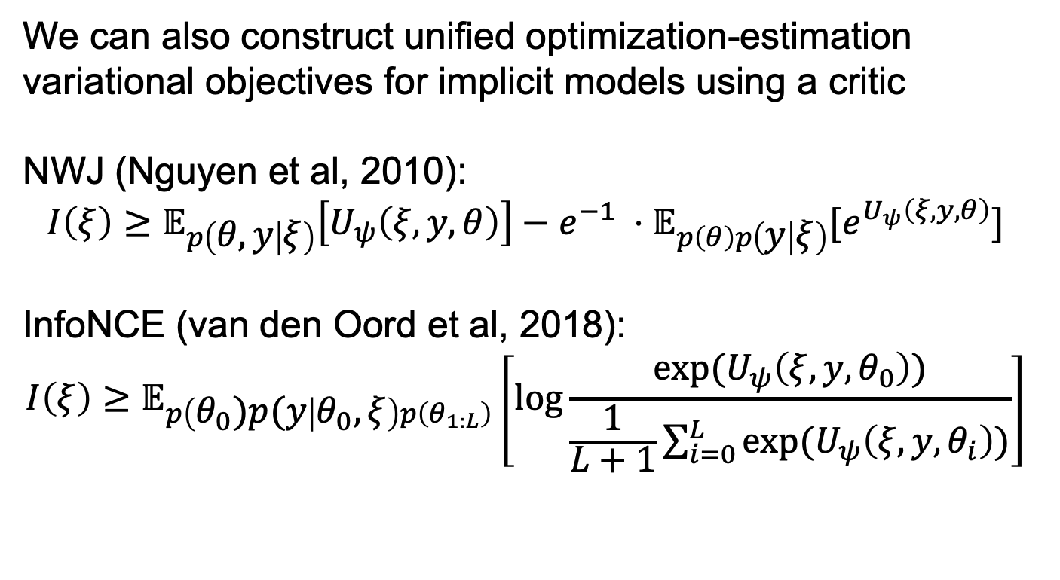
Implicit Variational Methods
We can also construct unified optimization-estimation variational objectives for implicit models using a critic
NWJ (Nguyen et al, 2010):
$$I\left(ξ\right)≥𝔼_{p\left(θ,y | ξ\right)}\left[U_{ψ}\left(ξ,y,θ\right)\right]−e^{−1} ⋅𝔼_{p\left(θ\right)p\left(y | ξ\right)}[e^{U_{ψ}\left(ξ, y,θ\right)}]$$
InfoNCE (van den Oord et al, 2018):
$$I\left(ξ\right)≥𝔼_{p\left(θ_{0})p(y | θ_{0},ξ\right)p\left(θ_{1:L}\right)}\left[\log{\frac{\exp{{(U}_{ψ}\left(ξ,y,θ_{0}\right))}}{\frac{1}{L+1}\sum_{i=0}^{L}{\exp{{(U}_{ψ}\left(ξ,y,θ_{i}\right))}}}}\right]$$
(Kleinegesse and Gutmann 2020, Ivanova et al., 2021)
Notes:
Avoid likelihood evaluations

Slide 32
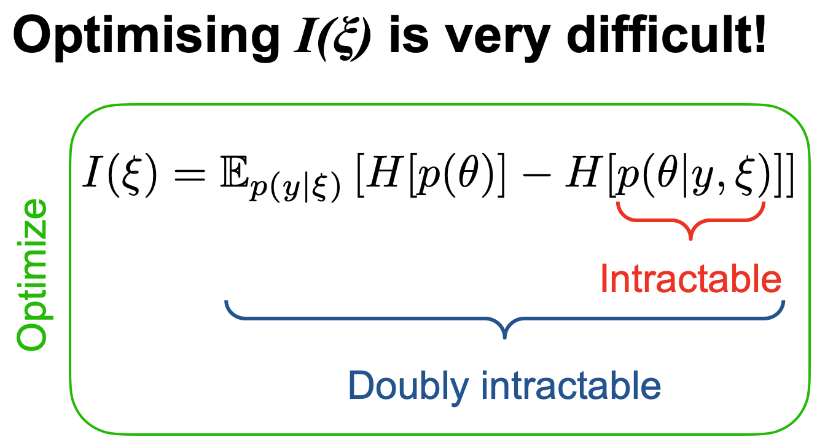

Slide 33
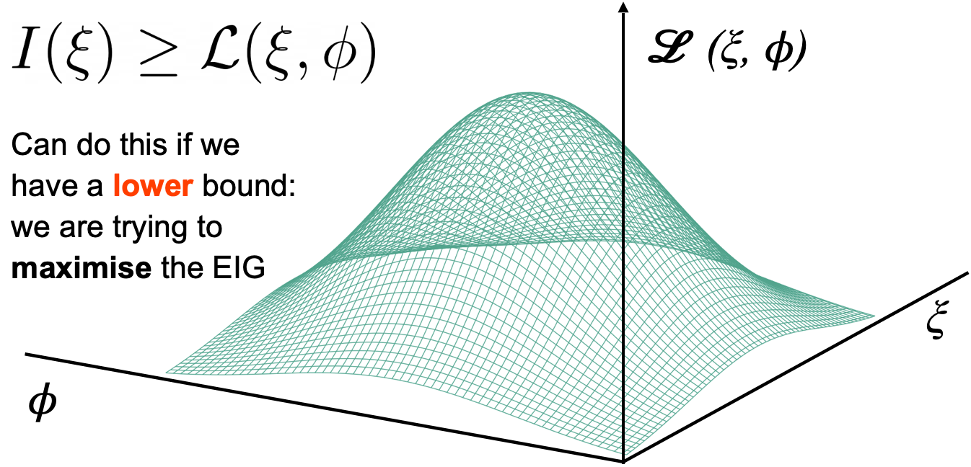

Variational Lower Bounds Provide Unified Objectives
$$\max_{ξ} I\left(ξ\right)=\max_{ξ,φ} ℒ(ξ,φ)$$
Optimize and estimate at same time using a variational bound
(Foster et al. 2020)

Slide 34

Stochastic gradient ascent

Slide 35

(Foster et al., 2020)

Slide 36

Alternative: Debiasing Schemes
A Multi-Level Monte Carlo (MLMC) estimator that is unbiased and finite-variance was recently discovered:
$$I\left(ξ\right)=𝔼\left[\frac{{\hat{μ}}_{NMC(M=M_{0}2^{ℓ})}−\frac{1}{2}\left({\hat{μ}}_{NMC\left(M_{0}2^{ℓ−1}\right)}^{(a)}+{\hat{μ}}_{NMC\left(M_{0}2^{ℓ−1}\right)}^{(b)}\right)}{q\left(ℓ\right)}\right]$$
where $ℓ∼q(ℓ)$ and the samples used in ${\hat{μ}}_{NMC(M=M_{0}2^{ℓ})}$ are split equally between ${\hat{μ}}_{NMC\left(M_{0}2^{ℓ−1}\right)}^{(a)}$ and ${\hat{μ}}_{NMC\left(M_{0}2^{ℓ−1}\right)}^{(b)}$
(Goda et al., 2022)
Notes:
Goda+

Slide 37

Is Fast Optimisation Enough?
Would you prefer £90 today or £100 in a year?
£100 in a year.
Ok, I am going to run a single stochastic gradient optimization over design space to convergence. Its very efficient… but you still need to wait

Slide 38


Traditional Framework is Slow!
Still requires inference + optimization at each step… slow
Fit posterior
Optimize EIG over ξ_{t}
Notes:
What do we mean by adaptive experimentation.
Explain the cycle starting with design.

Slide 39
We need the adaptation process to run in real time

Slide 40


DAD: Reimagining the Adaptive Pipeline
[DAD: Amortising Sequential Bayesian Experimental Design. Foster, Ivanova, Malik, Rainforth. ICML. 2021]
[iDAD: Policy-Based Experimental Design without Likelihoods. Ivanova, Foster, Kleinegesse, Gutmann, Rainforth. NeurIPS 2021]
Notes:
Get around 2nd prob - reinvent
Rather than direct opt of design, learn policy network that makes decisions automatically
Allows BAD in real time thus real problems
To get around the second problem about the fact that the computation has to happen during the experiment, we recently reinvented the traditional Bayesian adaptive pipeline itself with an approach we call deep adaptive design or dad for short.
Rather than optimising the designs directly, DAD instead learn a deep neural network called a policy network that can make design decisions for us automatically and almost instantaneously during the experiment
It therefore allows us deploy Bayesian adaptive design in real time and thus use it on real problems.
To address this, I propose reimagining the traditional adaptive pipeline itself.
Specifically, rather than optimising designs directly, I propose to instead learn design policy networks that can make design decisions automatically during the experiment
These policies will take the form of deep neural networks that take in the previously gathered data and output the next design decision
// Critically, because the expected information gain is only a function of our underlying model and design decisions, we can train this network upfront before the experiment, using only simulations from the model.
We then don’t need to perform any significant computations during the experiment itself, as only a single forward pass of a neural network is needed to make our design decisions and we no longer need to iteratively update our model

Slide 41

Deep Adaptive Design
Data Gathered So Far
Offline Training
Policy Network $π_{φ}$
Model
Next Design
Notes:
Deeper dive
Policy network takes in
Sketches example
Replaces expensive optimisation
Trained upfront
Also removes model updates - fixed policy
Same model across instantiations
To take a bit of a deeper dive on this DAD approach, this policy network is going to be a deep neural network that takes in all the previously gathered data and then returning the next design decision.
So in the sketches example, it would take in all the previous images and feedback and return the next image to show
The policy network therefore replaces the expensive optimisation of the expected information gain with a simple forward pass of a neural network
As I will explain shortly, the policy network can be trained upfront before the experiment using simulations from the model
It therefore also removes the need to make expensive model updates during the experiment as well, with the policy network fixed at the time the experiment starts
- Furthermore the same policy network can be deployed for each different instantiation of the experiment, such as different participants in a survey, without needing additional training

Slide 42


End-To-End Policy Objective
$$𝔼\left[\overset{T}{\underset{t=1}{∑}}EIG(d_{t})\right]$$
$$=𝔼_{{Data}_{1:T}(π_{φ})}\left[H[p(θ)]−H[p(θ|{Data}_{1:T}(π_{φ}))]\right]$$
$$≥𝔼_{θ,{Data}_{1:T}(π_{φ})}\left[log\frac{q_{ψ}(θ|{Data}_{1:T}(π_{φ}))}{p(θ)}\right]$$
Notes:
How to train?
Optimal policy - total EIG
Don’t need to think about individual iterations
TEIG only function of policy and model - simulations upfront
End-to-end bounds, SGA with simulated experimental rollouts
The key question is now how we should train this policy network?
Here we can note that the optimal policy will be the one that maximises the total expected information gained from all possible experiment iterations
Conveniently, we do not need to actually think about the information gathered from individual iterations here, only the total information conveyed by the final dataset
Critically, because the total expected information gain is only a function of our policy and our model, this training can be conducted using only simulations from the model and thus performed upfront before the experiment itself as desired.
In particular, we can set up end-to-end variants on the variational bounds from earlier to train the policy using stochastic gradient ascent on simulated experimental rollouts.
Critically, the network can be trained up-front. Namely, we can look to optimise the total expected information gained from all possible experiment iterations, and it turns out we can train the network to do this using only simulations from our generative model coupled with the variational bounds we just discussed.
So in other words, we can think of having experiment rollouts where we make decision decisions using our network as we go and simulate outcomes from our model, then we can back propagate gradients through this whole system to learn the network parameters that will lead to the most information being gathered in expectation

Slide 43












$$θ∼p(θ)$$
$$d_{1}=π_{φ}(∅)$$
$$y_{1}∼p(y|θ,d_{1})$$
$$d_{2}=π_{φ}((d_{1},y_{1}))$$
$$θ_{1}$$
$$y_{2}∼p(y|θ,d_{2})$$
Backpropagate
$$d_{3}=π_{φ}((d_{1},y_{1}),(d_{2},y_{2}))$$
$$θ_{2}$$
$$d_{T}=π_{φ}((d_{1},y_{1}),…,(d_{T−1},y_{T−1}))$$
Signal Strength
$$y_{T}∼p(y|θ,d_{T})$$
$$loss=−\overset{̂}{ℒ}((d_{1},y_{1}),…,(d_{T},y_{T}))$$
Notes:
First sample ground-truth theta using model, remind what is
Example = location of signal sources
Untrained policy makes first design decision
Example = position to query signal
Use model to simulate output = signal strength
Have first datapoint, feed into network
Continue until full simulated dataset
Evaluate loss and backpropagate
So how this stochastic gradient training is going to work is that we are are going to first use our model to sample some possible ground truth for theta, remembering this is what we are trying to learn about
// In the example on the side, this will be location of some signal sources we are trying to find
// Next we are going to use our, currently untrained, policy network to make our first design design decision
For our example, this will be a position that we are going to query the signal at
We then use our model to simulate a possible outcome for that first experiment iteration, which will correspond to a signal strength in our example
// We now have a first datapoint and we feed it into the policy network to get the second design
// We then just continue in the same way until we have gathered a full simulated dataset
We can evaluate a loss based on one of our variational bounds on the total expected information gain and backpropagate this loss to make a stochastic gradient update to our policy network parameters

Slide 44


$$θ∼p(θ)$$
$$d_{1}=π_{φ}(∅)$$
$$y_{1}∼p(y|θ,d_{1})$$
$$d_{2}=π_{φ}((d_{1},y_{1}))$$
$$θ_{1}$$
$$y_{2}∼p(y|θ,d_{2})$$
Backpropagate
$$d_{3}=π_{φ}((d_{1},y_{1}),(d_{2},y_{2}))$$
$$θ_{2}$$
$$d_{T}=π_{φ}((d_{1},y_{1}),…,(d_{T−1},y_{T−1}))$$
Signal Strength
$$y_{T}∼p(y|θ,d_{T})$$
$$loss=−\overset{̂}{ℒ}((d_{1},y_{1}),…,(d_{T},y_{T}))$$
Notes:
Repeat to train
Sampling theta and dates, making SGA updates
We now simply need to repeat this process to train the policy network
Sampling new possible values for theta and simulating new associated datasets at each iteration and making stochastic gradient updates to our policy

Slide 45









$$θ∼p(θ)$$
$$d_{1}=π_{φ}(∅)$$
$$y_{1}∼p(y|θ,d_{1})$$
$$θ_{1}$$
$$d_{2}=π_{φ}((d_{1},y_{1}))$$
$$y_{2}∼p(y|θ,d_{2})$$
$$θ_{2}$$
Backpropagate
$$d_{3}=π_{φ}((d_{1},y_{1}),(d_{2},y_{2}))$$
$$d_{T}=π_{φ}((d_{1},y_{1}),…,(d_{T−1},y_{T−1}))$$
Signal Strength
$$y_{T}∼p(y|θ,d_{T})$$
$$loss=−\overset{̂}{ℒ}((d_{1},y_{1}),…,(d_{T},y_{T}))$$
Notes:
Improves
Over time, the policy will improve

Slide 46


$$θ∼p(θ)$$
$$d_{1}=π_{φ}(∅)$$
$$y_{1}∼p(y|θ,d_{1})$$
$$θ_{1}$$
$$d_{2}=π_{φ}((d_{1},y_{1}))$$
$$y_{2}∼p(y|θ,d_{2})$$
$$θ_{2}$$
Backpropagate
$$d_{3}=π_{φ}((d_{1},y_{1}),(d_{2},y_{2}))$$
$$d_{T}=π_{φ}((d_{1},y_{1}),…,(d_{T−1},y_{T−1}))$$
Signal Strength
$$y_{T}∼p(y|θ,d_{T})$$
$$loss=−\overset{̂}{ℒ}((d_{1},y_{1}),…,(d_{T},y_{T}))$$
Notes:
Eventually effective
Example
Until eventually we have learned a very effective policy that gathers information very efficiently, thus finding the sources quickly in our example

Slide 47



$$d_{1}=π_{φ}(∅)$$
$$y_{1}∼RunExperiment(d_{1})$$
$$d_{2}=π_{φ}((d_{1},y_{1}))$$
$$y_{2}∼RunExperiment(d_{2})$$
$$d_{3}=π_{φ}((d_{1},y_{1}),(d_{2},y_{2}))$$
$$d_{T}=π_{φ}((d_{1},y_{1}),…,(d_{T−1},y_{T−1}))$$
Signal Strength
$$y_{T}∼RunExperiment(d_{T})$$
Notes:
Deploy without model
Only computation forward passes
To now deploy the policy, we simply remove the model and generate outcomes by running real iterations of the experiment instead
The only computation we now have to carry out during the experiment is these simple forward passes of the policy network to make our design decisions

Slide 48


Policy Networks Improve Design Quality
Deployment Time ($↓$)
Information Gained ($↑$)
Traditional BAD
2.5 hours
9.06 nats
DAD
0.005 s
12.38 nats
Avoids performing approximate inference
Learns non-greedy design strategies
Notes:
Huge improvements
Even more amazing = state-of-the-art data
Corrects important issues
As you might expect this now provide huge improvements in deployment time compared to the traditional approach, we the time for this particular example going from hours to milliseconds.
// What’s even more amazing is it also actually lead to a big improvement in state-of-the-art in the quality of the designs at the same time
This is because it turns out to also corrects some other important issue with the traditional framework, such as side-stepping most of the inference we would otherwise need to perform and allowing us to learn non greedy design strategies, unlike the traditional framework
Thus we will be simultaneously improving the state-of-the-art in both speed and accuracy
This’ll be game-changing for the field as design decisions that used to take hours will be made in milliseconds, allowing us to run things in real time
Here we’ve gone from hours to run previous approaches to mere milliseconds for DAD
What's even more amazing is it also actually improves the quality of the designs at the same time because it turns out it corrects other issues, such as side-stepping most of the inference we would otherwise need to perform and it allows us to learn non greedy design strategies, unlike the traditional framework
The upshot of these innovations is that we are now starting to consider applications that would have been completely unrealistic only a short time ago. In particular, we are starting to work with much higher dimensional and complex design space than used to be possible, while utilising much more powerful models.
The preliminary results for this approach have been extremely promising. We have found that the policy-based approach not only brings runtimes down from hours to milliseconds, but it also actually improves the quality of the designs at the same time, providing state-of-the-art data acquisition!
I thus believe thus it will represent a paradigm shift in the field and become the standard framework for information-based adaptive design in the coming years.
In fact, we find that it quite substantially improves on the previous state-of-the-art.
This is because it allows many of the normal inference challenges to be side stepped and because it allows non-greedy design strategies to be learned.

Slide 49
It actually gets better designs!?
DAD actually tends yield better designs as it a) avoids direct Bayesian inference and b) allows non-myopic policies to be learned
Myopic
Non-Myopic

Slide 50
Future Directions

Slide 51

Applying Bayesian Adaptive Design at Scale
Notes:
Plan high fidelity + DAD
The plan is to instead use high fidelity deep generative models coupled with our powerful DAD based approach to choose the images that are shown

Slide 52


Applying Bayesian Adaptive Design at Scale
Notes:
Hone
This will then allow us to more more quickly hone in on the suspect’s likeness

Slide 53

Applying Bayesian Adaptive Design at Scale
Notes:
More accurate final
And allow far more accurate reconstructions to be found

Slide 54




Applying Bayesian Adaptive Design at Scale
Notes:
Large scale climate simulations
Clinical trials
LLMS for adaptive surveys
Other applications I have lined up include controlling large scale climate simulations, configuring quantum information experiments, and leveraging large language models to conduct intelligent adaptive surveys.
In particular, a lot of work is required to scale up the approach to larger problems and mitigate the issues that are caused by model misspecification
, as it will provide a highly effective and practical framework for real-time adaptive data acquisition, thereby transforming how we gather data
, with the applications essential in demonstrating is capabilities and ensuring development is rooted in real-world problems.
The first is I'm really excited to exploit and keep building on these advances in adaptive design approaches.
We've seen how we've taken Bayesian adaptive design from an approach wasn't really practical to do to something that's very potentially powerful and very usable
That's opened up lots of avenues for research, both from a technical perspective, but also in terms of actually directly applying it as well
So we already spoke about these police sketches we are trying to work with, but we are also looking to work with climate scientists to try and help control their expensive simulations, and with quantum information researchers to help configure their experiments
For example, we have recently started working with some industry collaborators to use DAD for guiding the construction of police sketches from eyewitness memory. Here we want to learn about the true likeness of a suspect, and our adaptive experiment is going to be to show different images to the eyewitness and gather their feedback on them, such as for asking their preference between different possible sketches. We can then use this feedback to inform the future images we show them and so over time we can learn an increasingly good likeness of the true suspect in an adaptive manner.

Slide 55
Model Misspecification
Notes:
The first is I'm really excited to exploit and keep building on these advances in adaptive design approaches.
We've seen how we've taken Bayesian adaptive design from an approach wasn't really practical to do to something that's very potentially powerful and very usable
That's opened up lots of avenues for research, both from a technical perspective, but also in terms of actually directly applying it as well
So we already spoke about these police sketches we are trying to work with, but we are also looking to work with climate scientists to try and help control their expensive simulations, and with quantum information researchers to help configure their experiments

Slide 56

Model Misspecification
Notes:
The first is I'm really excited to exploit and keep building on these advances in adaptive design approaches.
We've seen how we've taken Bayesian adaptive design from an approach wasn't really practical to do to something that's very potentially powerful and very usable
That's opened up lots of avenues for research, both from a technical perspective, but also in terms of actually directly applying it as well
So we already spoke about these police sketches we are trying to work with, but we are also looking to work with climate scientists to try and help control their expensive simulations, and with quantum information researchers to help configure their experiments

Slide 57
Linking With Other Fields
Dog
Bird
Dog
Active Learning
Reinforcement Learning

Slide 58

Targeting the Right Thing
We can target information gain in any quantity of interest: $θ$ does not need to be the model parameters
If we have a mechanism for generating joint samples $θ,y|ξ$, this is enough the define ${EIG}_{θ}(ξ)$ and then optimize $ξ$

Slide 59
Expected Predictive Information Gain
Model Parameter EIG
Prediction-Orientated Bayesian Active Learning. Bickford Smith*, Kirsch*, Farquhar, Gal, Foster, and Rainforth. AISTATS, 2023 (to appear).

Slide 60
Curated Datasets Hide Flaws
(Bickford Smith et al., AISTATS, 2023)

Slide 61

Capturing Uncertainty
Do Bayesian Neural Networks Need to Be Fully Stochastic? Sharma, Farquhar, Nalisnick, and Rainforth. AISTATS, 2023.

Slide 62
Capturing Uncertainty
Making Better use of Unlabelled Data in Bayesian Active Learning. Bickford Smith, Foster, Rainforth. AISTATS, 2024

Slide 63
Recap
BED uses a generative model to formalize experiment optimality by considering the expected information gained about target variables
Adaptive BED approaches use information gathered from previous experiment iterations to guide future experiment iterations on the fly
Variational approaches provide a mechanism for circumventing the double intractability of the EIG and for simultaneously optimizing designs while performing this estimation
Policy-based BED approaches allow computation to be avoided during the experiment itself and give non-greedy design strategies
Lots of remaining challenges in scaling up and dealing with model misspecification

Slide 64











Thank you!
Tom Rainforth, Adam Foster, Desi Ivanova, Freddie Bickford Smith. Modern Bayesian Experimental Design. Statistical Science. 2024

Slide 65


Slide 66

Implicit Models
Often we only have a stochastic simulator of outcomes that we can sample from but not evaluate the density of
Deterministic function
Noise random variable
We need lower bounds that can be optimized using only samples
Outcome
Parameters
Designs
stochastic simulator
Notes:
The only thing we are going to assume about the implicit model is that we can differentiate the outcome wrt the design.

Slide 67

Critic Networks
Introduce an auxiliary critic network $U_{ψ}\left(ξ,y,θ\right)∈ℝ$
that approximates some intractable part of the EIG
One popular approach is for $U_{ψ}$ to approximate $log \frac{p(y|θ,ξ)}{p(y|ξ)}$
This can be done by training a classifier/discriminator
Once learnt, we can use $I\left(ξ\right)≈\frac{1}{N}\sum_{i=1}^{N}{U_{ψ}\left(ξ,y,θ\right)}$
(Thomas et al., 2016)
(Kleinegesse and Gutmann 2018)
Notes:
Avoid likelihood evaluations

Slide 68
Learn a design policy rather than learning individual designs!
(Foster et al., 2021)
Notes:
Deep Adaptive Design (DAD)
Fast Adaptive
This combination- not really been done before
What does that mean?

Slide 69
Design Policy
History h_{t-1} = ξ_{1:t-1} , y_{1:t-1}
π
Design ξ_{t}
Notes:
This network maps from Data to the next Design
This is the Design Network, also called the Design Policy

Slide 70



Rethinking with Policies
Design
Observation
Evaluate policy π with data h_{t-1}
Q?
A.
Output ξ_{t}
Notes:
What do we mean by adaptive experimentation.
Explain the cycle starting with design.

Slide 71






Policy-based BED
Offline training
Live experiment
Simulator $p(θ,y|ξ)$
Design
Deploy .
Design policy .
Observe
Past data .
Design
(Foster et al, 2021)

Slide 72


End-to-End Objective: Total EIG
The optimal policy maximises the expected total information gain across steps
where
Notes:
What does this give you an objective for the *policy*
We are going to parametrize this policy with neural nets

Slide 73

Train Using Lower Bounds
We can train end-to-end using unified lower bounds (or debiased estimators) and stochastic gradient schemes
Simple heuristics can also work very well, e.g. Sequential Prior Contrastive Estimation (sPCE) lower bound:
(Foster et al, 2021, Ivanova et al., 2021)
Notes:
So that’s a tractable objective
Use this as a surrogate objective to train the design policy

Slide 74
Deep Adaptive Design
Data
Design network
End-to-end objective
Tractable lower bound
Design
Adaptive experiments in real-time
Observation

Slide 75


Numerical results
 |  |  | Deployment time (sec.)
Heuristic (Frye et al. 2006) | 3.50 | 3.51 | 00.09
Traditional (Vincent & Rainforth 2017) | 4.45 | 4.54 | 25.27
DAD (Foster et al. 2021) | 5.02 | 5.12 | 00.09
Notes:
In the speaking, just mention the name of the probabilistic model you would use so it sounds “official” no need to put any equations of course
Harp on the need for real time design here

Slide 76
Location finding results
 |  |  | Deployment time (sec.)
Variational | 08.78 | 08.91 | 8963
DAD | 10.93 | 12.38 | 0.005
>1mil times faster
(Foster et al., 2021)
Notes:
Natural next question is how does the policy-based DAD method compare to traditional adaptive approaches that also use information from previous experiments.
Deployment time for variational ~2.5 hours for variational
Worth explaining intuitively why it would do so badly

Slide 77
Practical Adaptive Design at Scale
Notes:
The first is I'm really excited to exploit and keep building on these advances in adaptive design approaches.
We've seen how we've taken Bayesian adaptive design from an approach wasn't really practical to do to something that's very potentially powerful and very usable
That's opened up lots of avenues for research, both from a technical perspective, but also in terms of actually directly applying it as well
So we already spoke about these police sketches we are trying to work with, but we are also looking to work with climate scientists to try and help control their expensive simulations, and with quantum information researchers to help configure their experiments

Slide 78

Scaling Up

Slide 79

Scaling Up

Slide 80

BALD (EIG of model parameters) ignores the input distribution
This can cause lots of failures, e.g. acquisitions can become arbitrarily bad for large pools
(Bickford Smith et al., AISTATS, 2023)

Slide 81
Example: Adaptive Surveys
Q1
Answer 1
Q3
Q2
Answer 2
Notes:
\xi

Slide 82
Experimental Design
Machine learning has made huge advances in how to learn from acquired data
… but we often neglect to properly consider how we acquire that data in the first place
By applying tools from machine learning and statistics to experimental design, we can construct quantitative methods for gathering data effectively

Slide 83
Bayesian Experimental Design (BED)
Bayesian experimental design is a framework for formalizing experiment optimality using information theory
It is based on using a probabilistic generative model for experiment outcomes
It can be used to construct adaptive design algorithms that use information from previous data in future acquisition
Famous special cases include Bayesian active learning and Bayesian optimization

Slide 84

Bayesian Experimental Design

Slide 85

Location Finding Designs
Static
Adaptive
Notes:
How well does it work?
Quantitatively assess the design strategies: lower and upper bound on the total information gain
DAD outperforms NON-ADAPTIVE strategies by using information from previous iterations to make better design decisions

Slide 86

Variational approaches

Slide 87
How do we enable adaptive experimentation that is
as fast as a heuristic,
gives Bayesian-optimal designs
?
Notes:
Deep Adaptive Design (DAD)
Fast Adaptive
This combination- not really been done before
What does that mean?

Slide 88

How to Optimize the Policy?
The policy should maximize the expected sum of the individual EIGs
where

Slide 89
An End-to-End Objective
Sample from the prior, use the current policy to create designs, sample the likelihood
Notes:
What does this give you an objective for the *policy*
We are going to parametrize this policy with neural nets

Slide 90


Deep Adaptive Design (DAD)
Use a neural net policy π_{ϕ} and optimize the parameters ϕ to max
!
is not tractable
Optimize a tractable lower bound
(Foster et al, 2021)

Slide 91
Implicit Policy Bounds
Variational lower bounds on mutual information
NWJ (Nguyen et al, 2010)
Lower bias
Higher variance
InfoNCE (van den Oord et al, 2018)
Higher bias
Lower variance
Notes:
We give two alternatives with complementary properties

Slide 92
The state of play now
Would you prefer £90 today or £100 in a year?
£100 in a year.
One forward pass through policy network (~2ms)
Would you prefer £95 today or £100 in a year?

Slide 93
The state of play now
Would you prefer £90 today or £100 in a year?
£90 today
One forward pass through policy network (~2ms)
Would you prefer £80 today or £100 in a year?

Slide 94


DAD at work
(slowed down for visualisation)
Weak signal
Strong signal

Slide 95


Location finding: Adaptive design
 |  |  | Deployment time (sec.)
Variational | 08.78 | 08.91 | 8963
DAD | 10.93 | 12.38 | 0.005
>1mil times faster
No need for posterior estimation
Non-myopic properties of DAD
(Foster et al., 2021)
Notes:
Natural next question is how does the policy-based DAD method compare to traditional adaptive approaches that also use information from previous experiments.
Deployment time for variational ~2.5 hours for variational
Worth explaining intuitively why it would do so badly

Slide 96
Conclusion
Policy-based
Amortized
Non-myopic
Data
Deep Adaptive Design
Design network
End-to-end objective
Tractable lower bound
Design
Adaptive experiments in real-time
Observation

Slide 97




Policy-based BED without likelihoods
Offline training
Live experiment
Prior , implicit model .
Design
Data, Critic
Infer
Deploy .
T iterations
Design network
Critic network
Observe
Train , end-to-end using samples only
iDAD
Run experiments in real-time by deploying
Perform inference at end of experiment using
Notes:
To summarise: iDAD trains a design network and a critic network offline, prior to the experiment; deploying the design network enables quick design decisions during the live experiment; critic allows LF inference at the end of the experiment

Slide 98









Example: SIR Model
Susceptible
Infection rate
Total information lower bound
Infected
Random
1.91
Equal interval
2.67
Recovery rate
3.40
MINEBED
3.75
Recovered
SG-BOED
iDAD, NWJ
3.87
iDAD, InfoNCE
3.91

Slide 99



Location finding: real-time design
(Foster et al., 2021)
Notes:
How well does it work?
Quantitatively assess the design strategies: lower and upper bound on the total information gain
DAD outperforms NON-ADAPTIVE strategies by using information from previous iterations to make better design decisions

Slide 100


DAD: key ingredients
Data
Policy network
End-to-end objective
Tractable lower bound
Design
Observation
Notes:
At the heart is the approach is the Deep Adaptive Design policy network which learns to propose high quality designs by utlizing data from previous iterations;
To train it we derived a new unified objective - simplified the problem of INFERENCE + Optimising

Slide 101
The state of play: Summer 2018
Discrete design space?
Yes
No
Estimate EIG for each candidate design
Use Bayes Opt to search over designs
(Kleinegesse & Gutmann, 2018)

Slide 102
Two stage procedure to optimize the next design
Outer optimization over ξ
e.g. Bayesian Optimization
Inner estimation of expected information gain I(ξ)
Notes:
Existing methods then use a two stage procedure to find xi-star. They use an outer optimizer such as Bayesian Optimization to select which designs xi to be considered. This outer optimization treats the objective function as a black box non-differentiable function. At each step of the outer optimizer, an estimate of the expected information gain is made using: Nested Monte Carlo, variational estimation, or another estimator. The estimation of I at a new candidate design typically starts afresh without utilizing computation for previous designs.
Next slide should be our one stage

Slide 103
New idea!
Simultaneously estimate and optimize expected information gain I(ξ)
(Foster et al., 2020)
Notes:
The first key proposal of this work is that we can perform experimental design using a one stage procedure in which we simultaneously estimate and optimize expected information gain. This allows us to share computation between nearby designs, avoids visiting unpromising regions of the design space at all, and as well will show, scales to problems with hundreds of design dimensions. How does such a one stage procedure work? Mention stochastic gradient sascent

Slide 104
Variational EIG estimation
It’s not just an approximation, it’s a variational bound
(Foster et al., 2019)

Slide 105
Variational EIG estimation
We can train the function by minimizing the variational upper bound
(Foster et al., 2019)

Slide 106
Variational EIG estimation
Why is variational estimation faster?
Number of final samples
Cost of training q_{ɸ}
(Foster et al., 2019)

Slide 107
(Foster et al., 2019)

Slide 108
Variational methods give a nice speed-up in practice
train proposal
draw samples

Slide 109
Neural architecture
Theorem 3
The optimal policy is invariant to the order of the design-observation pairs

Slide 110
Neural architecture
Theorem 3
The optimal policy is invariant to the order of the design-observation pairs

Slide 111

We could have observed these points in any order
Weak signal
Strong signal

Slide 112

Neural architecture
ξ₁
y₁
r₁
E
ξ_{t}
…
…
F
ξ_{t-1}
y_{t-1}
r_{t-1}
E

Slide 113
How is DAD like Bayesian RL?
Similarities I
The evolution of states can be viewed as a BAMDP
Designs are actions
Policy is … policy

Slide 114
How is DAD like Bayesian RL?
Differences I: Reward
There is no observed reward for experimental design
Reward estimation is doubly intractable (see our 2019 NeurIPS paper)
Our unified objective and tractable lower bound wouldn’t be needed in standard RL

Slide 115
How is DAD like Bayesian RL?
Differences II: No Q-functions or critics
Because of the differences with the reward, the only thing we train is the policy: no Q-functions, V-functions, critics
We took a lot of effort to have our tractable lower bound be directly differentiable w.r.t. policy

Slide 116
How is DAD like Bayesian RL?
Similarities II
In model-based RL, we sometimes use an EIG-type reward to encourage exploration (e.g. Planning to explore via self-supervised world models)

Slide 117
How is DAD like Bayesian RL?
Differences III: No posteriors
Computationally, the model-based RL people seem to fit Gaussian posteriors, take variance of ensembles, etc
In DAD, we never fit posteriors, ever!
We optimize formally derived EIG bounds, rather than approximations

Slide 118
How is DAD like Bayesian RL?
Outlook
Now that DAD has solved the state representation problem (without posteriors) and the reward problem (unified objective, tractable bound), we could and should apply more RL machinery to the problem

Slide 119
What’s next?
Try to relax the assumptions of DAD
do we need to know the likelihood p(y|θ,ξ) explicitly?
what if the model changes between different experiments (e.g. time series)?

Slide 120


iDAD
Differentiable simulator model
can backprop

Slide 121
iDAD
We have to replace the sPCE objective with something that doesn’t require the likelihood
Let’s take our inspiration from the InfoNCE and NWJ bounds …

Slide 122
The state of play: Dec 2019
Would you prefer £90 today or £100 in a year?
£100 in a year.
Ok, next I need to setup up Bayes Opt to search over possible next questions. But don’t worry, each eval of the Bayes Opt uses a variational estimator.

Slide 123

The state of play: Dec 2019
Discrete design space?
Yes
No
Estimate EIG for each candidate design
Use Bayes Opt to search over designs
(Kleinegesse & Gutmann, 2018; Foster et al., 2019)

Slide 124
Stochastic gradient BOED
Discrete design space?
Yes
No
Estimate EIG for each candidate design
Use a unified stochastic gradient procedure
(Foster et al., 2020)

Slide 125

Traditional approach
These are hard problems!
Fit posterior
Optimize EIG over ξ_{t}
Notes:
What do we mean by adaptive experimentation.
Explain the cycle starting with design.

Slide 126

Traditional Bayesian adaptive design
Live experiment
Design
T iterations
Infer
Observe

Slide 127
Deep Adaptive Design (DAD): Adaptive Design in Real Time
Offline training
Live experiment
Model
Design
Infer
Deploy .
Data
T iterations
Design policy .
Observe
Past data .
Design
(Foster et al, 2021)

Slide 128
Thank you
Notes:
That only leaves me to thank my collaborators: Martin Jankowiak, Matt O’Meara, Yw Teh and Tom Rainforth. These methods are implemented in a fork of Pyro & here’s a link to the full paper. Thank you very much!
TALK ENDS HERE

